Slide 1
Technical Presentations & Area Survey Reports
Lars Kulik, Egemen Tanin and Rao Kotagiri

Slide 2
Why...
Technology changes rapidly
New areas emerge all the time
It is important to survey these changes
Formal way of doing this:
Present to colleagues or investors
Report to managers
Precursor to writing a white-paper for a company positioning itself in the area
First step during PhD studies
First Chapter of a PhD/Masters thesis
Expected from anyone with a Masters level degree in IT to be able to produce a quality review of chosen technical topic in IT

Slide 3
Where You are Now...
Hopefully you have decided on an area
Googled basic terms and found a pool of information
Good for high-level info, such as sales, products, etc.
Then went to more specialized sources
Scholar.google.com: Found technical information and details
Read papers at high-level
Technical papers are not to be read like a novel
Need to understand 100% -- if not clear look for other resources for understanding
Formed an opinion about techniques, products, etc.

Slide 4
Next...
Prepare a presentation to colleagues who may have IT background but do not know the area in detail

Slide 5
Presentations: Three Most Important Things
Organization
Visual Aids
Delivery and Style

Slide 6
Be clear on: the Purpose & your Audience
Be clear about purpose of your talk
What do you want your audience to learn?
Audience analysis
Identify your audience and their understanding of the area

Slide 7
Introduction
Earn the audience’s attention
Roadmap
Explain where you plan to go, set up the story
Create a table or figure to organize the area
“Don’ts”
Apologize for being nervous
Read the introduction
Keep it simple for the Introduction
No excessive use of technical abbreviations
Note: The time allotted to you is comparable to a standard conference presentation

Slide 8
Body of your Presentation
Create main points
Presentation & Language
Present points as declarative statements
Keep speech points unified, coherent, and balanced
Verbalize connections between points
Do not form full sentences on slides
Do not spend time on code or formulas unless it is a must
Any symbols used must be defined and do not use more than 4 in any single slide if possible

Slide 9
Some Formatting Issues: Fonts Are Important!
Use sans serif fonts
Use readable font sizes
Use appropriate color combinations
40 point Title
28 point Heading
24 point Sub-headings
18 point References and Labels
Avoid using 12 point font or smaller

Slide 10
Fonts Will Make or Break a Presentation
Use sans serif fonts
Use readable font sizes
Use appropriate color combinations
40 point Title
28 point Heading
24 point Sub headings
18 point References and Labels
Avoid using 12 point font or smaller

Slide 11
Visual Aids Do’s and Don’ts
Do’s
Design them large enough
Design them to be simple
Design them to be clear
Label them
Use only what you need
Don’ts
Use too much text
Use excessive artwork
Make things look cramped
Use too many colors
Overuse capital letters

Slide 12
Transitions
A word or phrase that signals when a speaker is moving from a topic or handing over to the next presenter
Two parts to a transition
Idea that the speaker is leaving [the review part]
Idea that the speaker is coming up to [the preview part]
Example
Now that you have seen a general overview of XYZ [review], I will discuss each of them in turn [preview]
Use a map to remind people which part of a presentation or area in a survey you are coming from and going to

Slide 13
“Conclusions”
Purpose: Tell them what you told them
Use a slide or two for comparing approaches
Use figures, tables, charts
Offers the audience a sense of closure
Tips
Signal the end verbally and non-verbally
Make conclusions strong and brief
“Don’ts”
Drag out the conclusion
End on a weak or rambling note
Introduce new points

Slide 14
More Tips
Capital letters
Bullet points typically have one capital letter at the beginning
Just because You think a Word is Important does NOT mean you should Emphasize things all the time
ALL CAPITAL LETTERS MAKEs IT HARD FOR YOUR AUDIENCE TO READ
Exclamation marks: Don’t use it too much!!!!!!!!!!!!!!!!!!!!!!

Slide 15
Practicing
It is the most important aspect of a presentation
You will find out if you
Make sense and sound knowledgeable
How to practice
Highlight in your notes difficult pronunciations
Practice in a room similar to where you will present
Imagine the audience to whom you will present
Always practice out loud

Slide 16
Establishing Credibility
Make sure you know your stuff
Speak loud enough
Look at your audience
Don’t assume your audience knows
Watch for audience’s non-verbal feedback
Adjust your rate, content, or eye contact for them

Slide 17
Handling Questions and Answers
Decide who will answer which types of questions and when
Use welcoming body language
Reword the question before answering
Say “I don’t know” if necessary

Slide 18
Teamwork Considerations
Work out all transitions
Between sections
Between team members
Practice as a team
Speak with one voice
Give the speaking member full attention
If you look distracted it will make your audience distracted

Slide 19
Reports
A good presentation design → A good report
Even if you do not perform well in a presentation, the audience feedback is good feedback as well
Structure is pretty much the same for the presentations as well as the report
Figures should be reused so they are not wasted
Audience considerations directly translate
Many issues such as Introduction being simple directly applies

Slide 20
Structure of a Report
Title, authors, and abstract (no more than 1 page)
Introduction (3 pages max)
Should be high-level
Use a chart to organize the area

Slide 21
Details on Related Work
Background and critical analysis (10 pages in two or three sections)
Background cannot be a simple list of papers
This is the most important issue for a survey
Organize into subcategories/sections
Figure out parameters that matter for comparison
Create a table of comparison (or two)

Slide 22
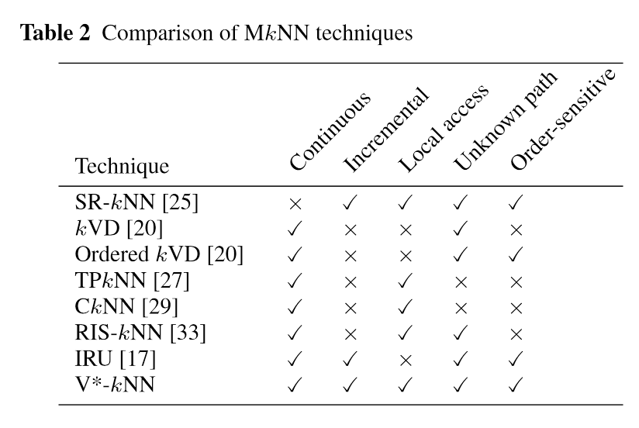
An Example Comparison Table

Slide 23
Wrapping It Up
Conclusions and future directions (2 pages)
Do not underestimate yourself
Do not repeat the Introduction
References and sources (2 pages)
You should cite extensively for a survey but exclude papers with incremental contributions
Use: citation counts, source of the paper, author reputations, etc.
Do not cite papers that you have not read for the survey
Citations should be done professionally
Follow ACM Computing Survey style for the formatting

